Slide 1
Lab 12 MONGO DB- CRUD operations
Course Code:
Engr. Ayesha Khan
DATABASE MANAGEMENT SYSTEM

Slide 2
What is Mongo Database
MongoDB is an open-source document database and leading NoSQL database. MongoDB is written in C++.

Slide 3
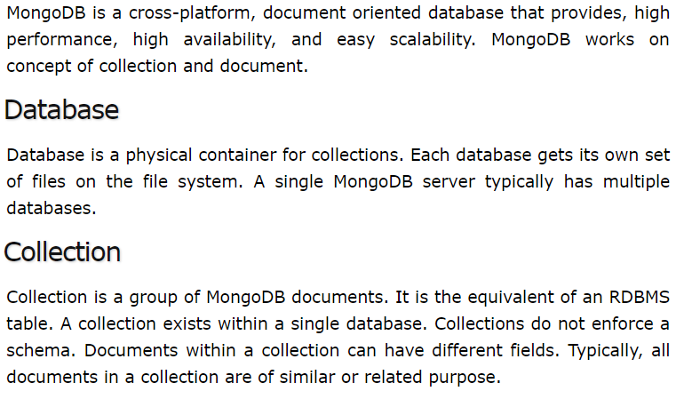

Slide 4
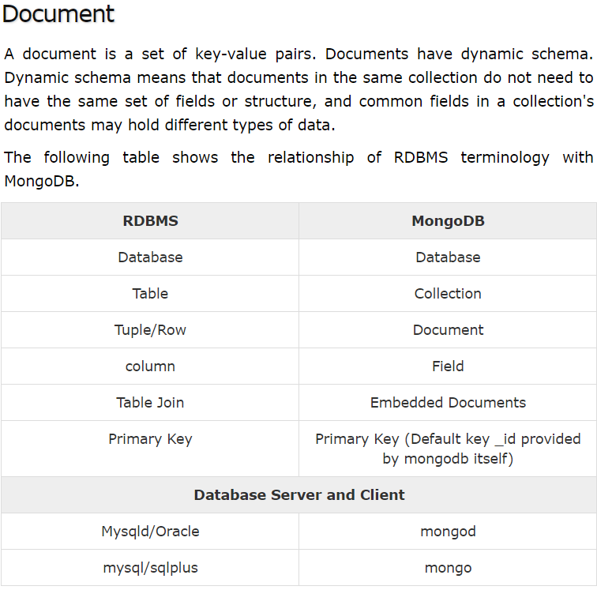

Slide 5
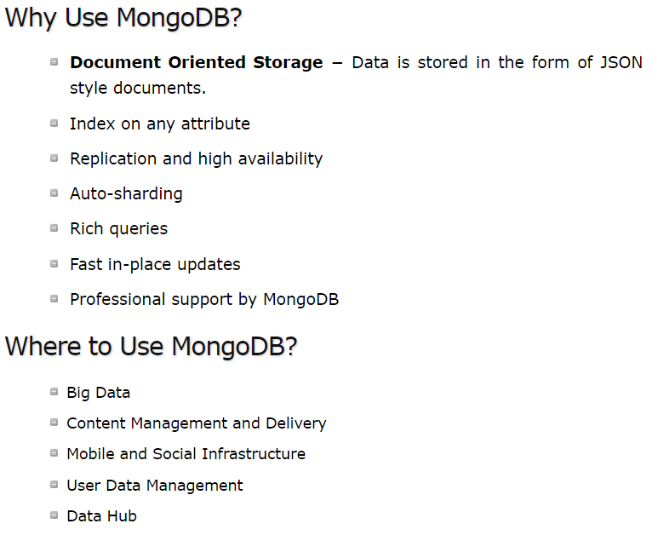

Slide 6
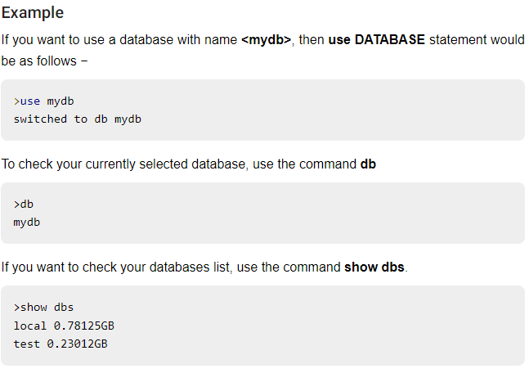
Create database
Your created database (mydb) is not present in list. To display database, you need to insert at least one document into it.

Slide 7
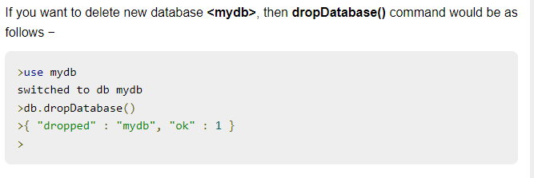
Drop Db

Slide 8
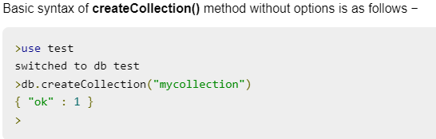
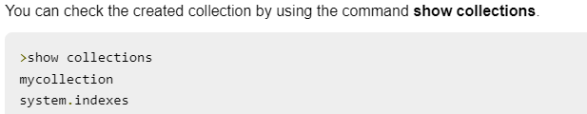
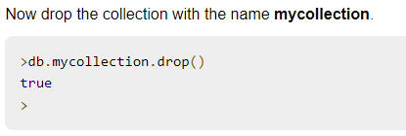
Create Collection
Drop Collection

Slide 9
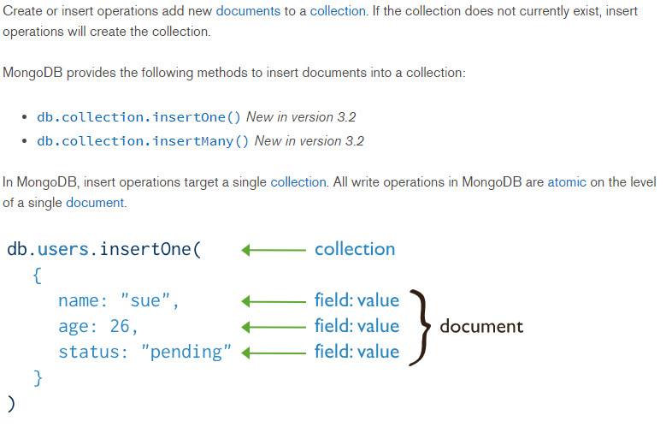
Insert document in collection

Slide 10
Example
Insert one | Insert many
db.inventory.insertOne( { item: "canvas", qty: 100, tags: ["cotton"], size: { h: 28, w: 35.5, uom: "cm" } } ) | db.inventory.insertMany([ { item: "journal", qty: 25, tags: ["blank", "red"], size: { h: 14, w: 21, uom: "cm" } }, { item: "mat", qty: 85, tags: ["gray"], size: { h: 27.9, w: 35.5, uom: "cm" } }, { item: "mousepad", qty: 25, tags: ["gel", "blue"], size: { h: 19, w: 22.85, uom: "cm" } } ])

Slide 11
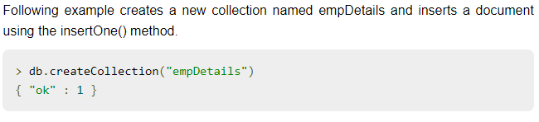
Insert in collection
db.empDetails.insertOne( {
First_Name: “Hanniya",
Last_Name: “Khan",
Date_Of_Birth: “29-06-2012", e_mail:“hanniyakhan123@gmail.com",
phone: "9848022338" })

Slide 12
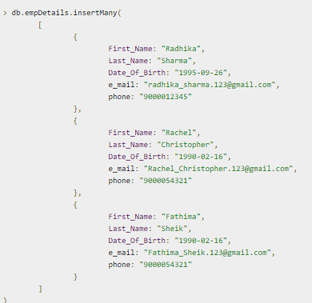
Multiple document insert

Slide 13
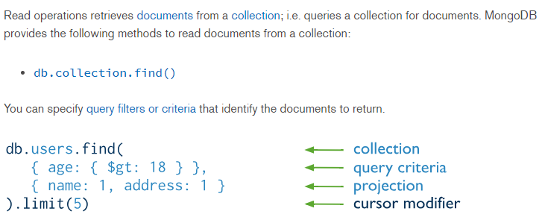
Read Operation
db.empDetails.find()

Slide 14
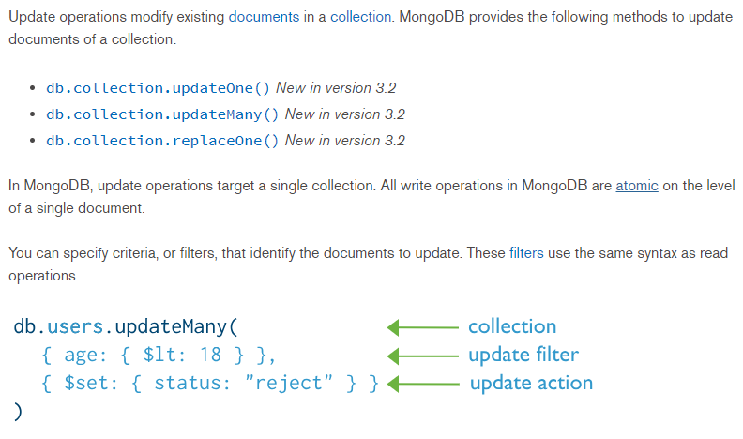
Update operation

Slide 15
Example
Update one | Update many | Replace one
try { db.restaurant.updateOne ( { "name" : "Central Perk Cafe" }, { $set: { "violations" : 3 } } ); } catch (e) { print(e); } | try { db.inspectors.updateMany ( { "Sector" : { $gt : 4 }, "inspector" : "R. Coltrane" }, { $set: { "Patrolling" : false } }, { upsert: true } ); } catch (e) { print(e); } | try { db.restaurant.replaceOne( { "name" : "Pizza Rat's Pizzaria" }, { "_id": 4, "name" : "Pizza Rat's Pizzaria", "Borough" : "Manhattan", "violations" : 8 }, { upsert: true } ); } catch (e){ print(e); }

Slide 16
findOneAndUpdate vs updateOne
findOneAndUpdate returns a document whereas updateOne does not (it just returns the _id if it has created a new document). I think that's the main difference. So the use case of updateOne is when you don't need the document and want to save a bit of time and bandwidth

Slide 17
findOneAndUpdate
db.empDetails.findOneAndUpdate( {First_Name: ‘Hanniya'},
{ $set: {
First_Name: ‘Laiba’,
e_mail:’laiba@gmail.com'}} )

Slide 18
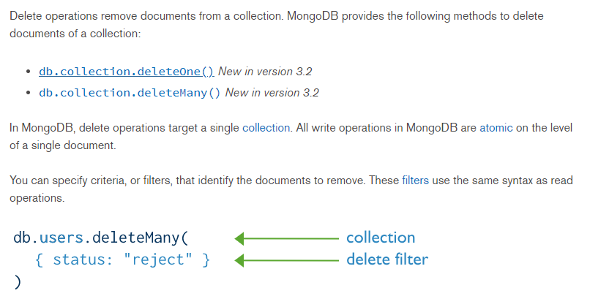
Delete Operation

Slide 19
Example
Delete one
try { db.orders.deleteOne ( { "_id" : ObjectId("563237a41a4d68582c2509da") } ); } catch (e) { print(e); } | try { db.orders.deleteMany ( { "client" : "Crude Traders Inc." } ); } catch (e) { print (e); }

Slide 20


Delete document

Slide 21
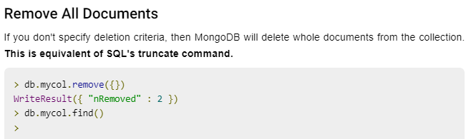
Remove

Slide 22
TASKS
Create a database of a company which will hold employee info(_id,name,designation,salary,department) and department info(_id,name), insert 5 records on each table.
Increase employee salary to 10% if salary =10000
View all records updated
Delete records from department where department id is 5

Slide 23
Thank You

